Slide 1







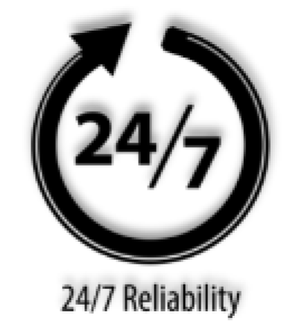
ASUS NUC 15 PRO
Best Compact Choice for the AI-Driven Future.
Introducing the ASUS NUC 15 Pro—where intelligent design meets unparalleled performance. Its compact form factor is engineered for versatility, making it ideal for a variety of development scenarios, from AI model training to data visualization. Powered by the latest Gen Intel® Core™ Ultra processors, DDR5 6400 MHz memory, and Intel® Arc GPU, it delivers exceptional speed and efficiency. Experience lightning-fast connectivity and seamless collaboration with cutting-edge Wi-Fi 7. Elevate your workflow and adapt to any environment with the NUC 15 Pro—your compact powerhouse for innovation.
Key Selling Points
AI-Optimized Power: Features the Latest Gen Intel® Core™ Ultra Series 2 CPU, Up to 99 Platform TOPS, optimized for a wide range of workloads delivering up to 18% gen/gen performance
Superior Connectivity: Features Intel® Wi-Fi 7 with up to 2.4X faster transfer rates, Wi-Fi Proximity Sensing, and certified Bluetooth® for enhanced audio quality and seamless connections.
Robust Security: Robust Security: With Intel® vPro™ on Arrow Lake architecture, offering faster threat detection and fTPM 2.0 for stronger data protection.
Integrated & Expandable: Compact 0.48L design with a tool-less 2.0 chassis for quick upgrades, offering 6X faster integration gen/gen.
Exceptional Display Potential: Connect to four 4K displays via HDMI 2.1 and Thunderbolt™ 4, with headless emulation. New sync power-off feature automatically shuts the screen for better energy efficiency
Reliable & Sustainable: Features 24/7 reliability with rigorous torture testing and MIL-STD-810H certification, ensuring durability in extreme conditions. The advanced cooling system enhances reliability by maintaining optimal performance, and eco-friendly packaging reflects a commitment to sustainability.
Audience:
Target Usages:
Small and Medium Business Enterprises
Retail
Education
Collaboration
Remote Workers
Traditional and Smart Classrooms
Communication File Sharing/ Virtual Meetings
Daily Tasks/ Entertainment
Digital Signage / Kiosk / POS
Specifications, content, and product availability are all subject to change without notice and may differ from country to country.
Actual performance may vary depending on the application, usage, environment, and other factors. Full specifications are available at http://www.asus.com

Slide 2
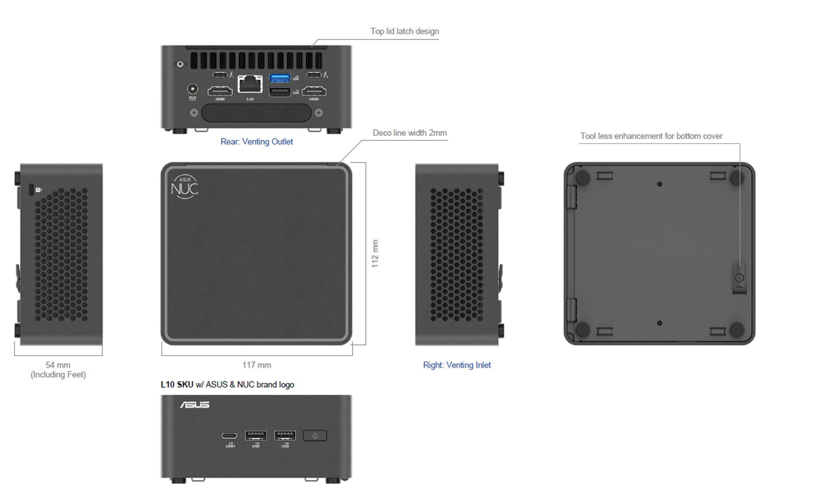
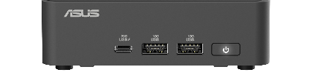
ASUS NUC 15 PRO
Image A
Image B
Mini-PC Specifications
Marketing Name | ASUS NUC 15 PRO Mini-PC (Tall) | ASUS NUC 15 PRO Mini-PC (slim)
Photo | Image A | Image B
ASUS Logo | Yes | Yes
ASUS NUC Logo | Yes | Yes
Color | Black | Black
OS Support | Microsoft Windows 11 Pro | Microsoft Windows 11 Pro
CPU | Intel® Core™ Ultra 7 265H (vPro) Intel® Core™ Ultra 5 235H (vPro) Intel® Core™ Ultra 7 255H Intel® Core™ Ultra 5 225H Intel® Core™ 7 240H Intel® Core™ 5 210H Intel® Core™ 3 100U | Intel® Core™ Ultra 7 265H (vPro) Intel® Core™ Ultra 5 235H (vPro) Intel® Core™ Ultra 7 255H Intel® Core™ Ultra 5 225H Intel® Core™ 7 240H Intel® Core™ 5 210H Intel® Core™ 3 100U
Chipset | Integrated | Integrated
Graphics | Intel® Arc™ GPU (Core Ultra)¹ Intel® Graphics (Core3, Core 5, Core 7) | Intel® Arc™ GPU (Core Ultra)¹ Intel® Graphics (Core3, Core 5, Core 7)
Memory | 2 x SO-DIMM, Up to DDR5-5600, 48GB*2 (Core 3, Core 5, Core 7) 2 x CSO-DIMM, Up to DDR5-6400, 48GB*2 (Core Ultra) | 2 x SO-DIMM, Up to DDR5-5600, 48GB*2 (Core 3, Core 5, Core 7) 2 x CSO-DIMM, Up to DDR5-6400, 48GB*2 (Core Ultra)
Storage | 1 x M.2 2280 PCIe Gen4x4, supports 128GB~2TB NVMe SSD 1 x M.2 2242 PCIe Gen4x4, supports 128GB~2TB NVMe SSD PCIe Gen 5 ready design | 1 x M.2 2280 PCIe Gen4x4, supports 128GB~2TB NVMe SSD 1 x M.2 2242 PCIe Gen4x4, supports 128GB~2TB NVMe SSD PCIe Gen 5 ready design
Wireless Network | Intel® Wi-Fi 7 BE201 + Bluetooth 5.4 (Core Ultra) Intel® Wi-Fi 7 BE202 + Bluetooth 5.4 (Core 3, Core 5, Core 7) | Intel® Wi-Fi 7 BE201 + Bluetooth 5.4 Intel® Wi-Fi 7 BE202 + Bluetooth 5.4 (Core 3, Core 5, Core 7)
LAN | Intel® Ethernet Controller I226-V/LM, 2.5G² | Intel® Ethernet Controller I226-V/LM, 2.5G²
Audio | Up to 7.1 multichannel (or 8-channel) digital audio on HDMI and DP Type-C ports | Up to 7.1 multichannel (or 8-channel) digital audio on HDMI and DP Type-C ports
TPM | fTPM | fTPM
Card Reader | None | None
HDMI CEC | Yes, 2 ports on back panel | Yes, 2 ports on back panel
Front I/O Ports | 1 x USB 3.2 Gen2x2 Type-C 2 x USB 3.2 Gen2 Type-A | 1 x USB 3.2 Gen2x2 Type-C 2 x USB 3.2 Gen2 Type-A
Back I/O Ports | 2 x HDMI 2.1 TMDS Compatible (4K@60Hz) 2 x Thunderbolt™ 4 ports (incl. DP 2.1 and USB4) 1x USB 3.2 Gen2 Type-A 1x USB 2.0 Type-A 1 x RJ45 LAN 1 x DC-in | 2 x HDMI 2.1 TMDS Compatible (4K@60Hz) 2 x Thunderbolt™ 4 ports (incl. DP 2.1 and USB4) 1x USB 3.2 Gen2 Type-A 1x USB 2.0 Type A 1 x RJ45 LAN 1 x DC-in
Side I/O Ports | 1 x Kensington Lock | 1 x Kensington Lock
Power Supply | Power supply adapter (120W/19VDC for Core Ultra 5, 7, Core 5, 7; 90W/19VDC for Core 3) with geo-specific AC cord (IEC C5) | Power supply adapter (120W/19VDC for Core Ultra 5, 7, Core 5, 7; 90W/19VDC for Core 3) with geo-specific AC cord (IEC C5)
Operating Temp | 0 to 40C | 0 to 40C
Storage Temp | -40 to 60C | -40 to 60C
Humidity | 0%-92% non-condensing³ | 0%-92% non-condensing³
Dimensions (W x D x H) | 117mm x 112mm x 54mm | 117mm x 112mm x 37mm
Weights | 364.3g | 357.4g
Accessories | AC Adapter+Power Cord⁴ VESA Bracket and Screws Cable Clip Safety/Caution/Regulatory Insert Warranty Card | AC Adapter+Power Cord⁴ VESA Bracket and Screws Cable Clip Safety/Caution/Regulatory Insert Warranty Card
⁽¹⁾ Intel® Arc™ GPU requires using 2 x SO-DIMM
⁽²⁾ Intel® Ethernet Controller I226-LM included on vPro enabled systems
⁽³⁾ Humidity Info detail please check link: Non-condensing humidity as defined by temperature vs dew point
⁽⁴⁾ Power cord included is region specific, and some SKUs do not include the power cord
Specifications, content, and product availability are all subject to change without notice and may differ from country to country.
Actual performance may vary depending on the application, usage, environment, and other factors. Full specifications are available at http://www.asus.com

Slide 3
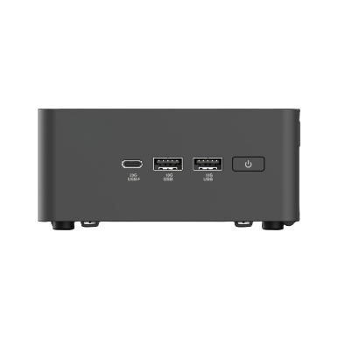
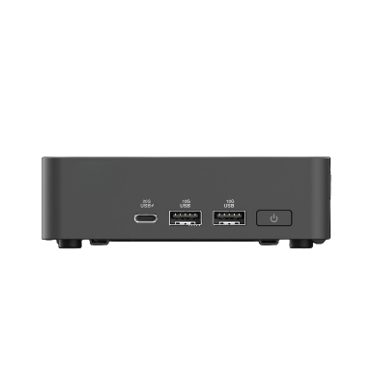
ASUS NUC 15 PRO
Image C
Image D
Kit Specifications
Marketing Name | ASUS NUC 15 PRO Kit (Tall) | ASUS NUC 15 PRO Kit (Slim)
Photo | Image C | Image D
ASUS Logo | No | No
ASUS NUC Logo | No | No
Color | Black | Black
OS Support | Microsoft Windows 11 Pro Ubuntu 24.04 LTS 64-bit RedHat Enterprise Linux 64-bit No OS installed at shipment | Microsoft Windows 11 Pro Ubuntu 24.04 LTS 64-bit RedHat Enterprise Linux 64-bit No OS installed at shipment
CPU | Intel® Core™ Ultra 7 265H (vPro) Intel® Core™ Ultra 5 235H (vPro) Intel® Core™ Ultra 7 255H Intel® Core™ Ultra 5 225H Intel® Core™ 7 240H Intel® Core™ 5 210H Intel® Core™ 3 100U | Intel® Core™ Ultra 7 265H (vPro) Intel® Core™ Ultra 5 235H (vPro) Intel® Core™ Ultra 7 255H Intel® Core™ Ultra 5 225H Intel® Core™ 7 240H Intel® Core™ 5 210H Intel® Core™ 3 100U
Chipset | Integrated | Integrated
Graphics | Intel® Arc™ GPU (Core Ultra)¹ Intel® Graphics (Core 3, 5, 7) | Intel® Arc™ GPU (Core Ultra)¹ Intel® Graphics (Core 3, 5, 7)
Memory | 2 x SO-DIMM, Up to DDR5-5600, 48GB*2 (Core 3, Core 5, Core 7) 2 x CSO-DIMM, Up to DDR5-6400, 48GB*2 (Core Ultra) No memory installed at shipment | 2 x SO-DIMM, Up to DDR5-5600, 48GB*2 (Core 3, Core 5, Core 7) 2 x CSO-DIMM, Up to DDR5-6400, 48GB*2 (Core Ultra) No memory installed at shipment
Storage | 1 x M.2 2280 PCIe Gen4x4, supports 128GB~2TB NVMe SSD 1 x M.2 2242 PCIe Gen4x4, supports 128GB~2TB NVMe SSD No storage installed at shipment PCIe Gen 5 ready design | 1 x M.2 2280 PCIe Gen4x4, supports 128GB~2TB NVMe SSD 1 x M.2 2242 PCIe Gen4x4, supports 128GB~2TB NVMe SSD No storage installed at shipment PCIe Gen 5 ready design
Wireless Network | Intel® Wi-Fi 7 BE201 (Gig+), Bluetooth 5.4 (Core Ultra) Intel® Wi-Fi 7 BE202 (Gig+), Bluetooth 5.4 (Core 3, Core 5, Core 7) | Intel® Wi-Fi 7 BE201 (Gig+), Bluetooth 5.4 (Core Ultra) Intel® Wi-Fi 7 BE202 (Gig+), Bluetooth 5.4 (Core 3, Core 5, Core 7)
LAN | Intel® Ethernet Controller I226-V/LM, 2.5G² | Intel® Ethernet Controller I226-V/LM, 2.5G²
Audio | Up to 7.1 multichannel (or 8-channel) digital audio on HDMI and DP Type-C ports | Up to 7.1 multichannel (or 8-channel) digital audio on HDMI and DP Type-C ports
TPM | fTPM | fTPM
Card Reader | None | None
HDMI CEC | Yes, 2 ports on back panel | Yes, 2 ports on back panel
Front I/O Ports | 1 x USB 3.2 Gen2x2 Type-C 2 x USB 3.2 Gen2 Type-A | 1 x USB 3.2 Gen2x2 Type-C 2 x USB 3.2 Gen2 Type-A
Back I/O Ports | 2 x HDMI 2.1 TMDS Compatible (4K@60Hz) 2 x Thunderbolt™ 4 ports (incl. DP 2.1 and USB4) 1x USB 3.2 Gen2 Type-A 1x USB 2.0 Type A 1 x RJ45 LAN 1 x DC-in | 2 x HDMI 2.1 TMDS Compatible (4K@60Hz) 2 x Thunderbolt™ 4 ports (incl. DP 2.1 and USB4) 1x USB 3.2 Gen2 Type-A 1x USB 2.0 Type A 1 x RJ45 LAN 1 x DC-in
Side I/O Ports | 1 x Kensington Lock | 1 x Kensington Lock
Power Supply | Power supply adapter (120W/19VDC for Core Ultra 5, 7, Core 5, 7; 90W/19VDC for Core 3) with geo-specific AC cord (IEC C5) | Power supply adapter (120W/19VDC for Core Ultra 5, 7, Core 5, 7; 90W/19VDC for Core 3) with geo-specific AC cord (IEC C5)
Operating Temp | 0 to 40C | 0 to 40C
Storage Temp | -40 to 60C | -40 to 60C
Humidity | 0%-92% non-condensing³ | 0%-92% non-condensing³
Dimensions (W x D x H) | 117mm x 112mm x 54mm | 117mm x 112mm x 37mm
Weights | 364.3g | 357.4g
Accessories | AC Adapter+Power Cord⁴ VESA Bracket and Screws Cable Clip Safety/Caution/Regulatory Insert Warranty Card | AC Adapter+Power Cord⁴ VESA Bracket and Screws Cable Clip Safety/Caution/Regulatory Insert Warranty Card
⁽¹⁾ Intel® Arc™ GPU requires using 2 x SO-DIMM
⁽²⁾ Intel® Ethernet Controller I226-LM included on vPro enabled systems
⁽³⁾ Humidity Info detail please check link: Non-condensing Humidity defined by dew point
⁽⁴⁾ Power cord included is region specific, and some SKUs do not include the power cord
Specifications, content, and product availability are all subject to change without notice and may differ from country to country.
Actual performance may vary depending on the application, usage, environment, and other factors. Full specifications are available at http://www.asus.com

Slide 4
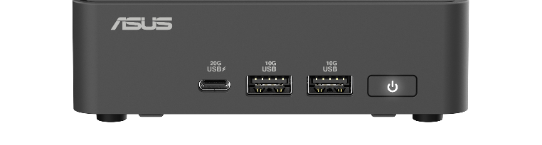
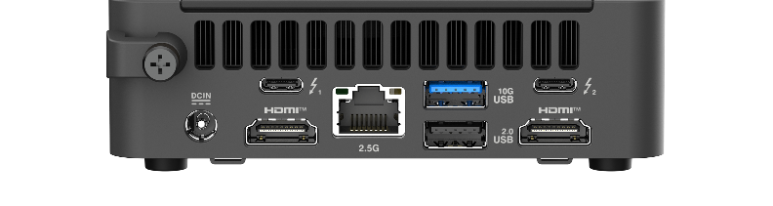
ASUS NUC 15 PRO
Tall
Kensington Lock
2
1
3
4
5
6
7
8
9
10
6
7
1. 2x USB 3.2 Gen2 Type-A
2. USB 3.2 Type-C Gen 2x2
3. Power button
4. Security mechanism for power cable
5. DC-in
6. 2x HDMI 2.1 (TMDS)
7. 2x ThunderboltTM 4
8. 2.5Gb Ethernet Port
9. USB 2.0 Type-A
10. USB 3.2 Gen2 Type-A
* All USB ports with individual USB power control
Slim
Kensington Lock
2
1
3
4
5
6
7
8
9
10
6
7
1. 2x USB 3.2 Gen2 Type-A
2. USB 3.2 Gen 2x2 Type-C
3. Power button
4. Security mechanism for power cable
5. DC-in
6. 2x HDMI 2.1 (TMDS)
7. 2x ThunderboltTM 4
8. 2.5Gb Ethernet Port
9. USB 2.0 Type-A
10. USB 3.2 Gen2 Type-A
Specifications, content, and product availability are all subject to change without notice and may differ from country to country.
Actual performance may vary depending on the application, usage, environment, and other factors. Full specifications are available at http://www.asus.com

Slide 5
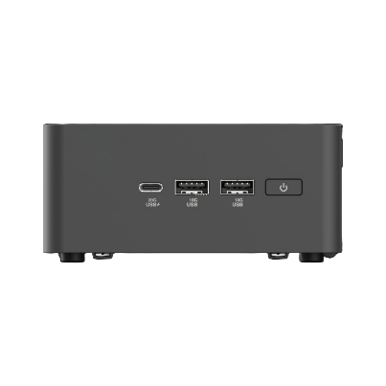
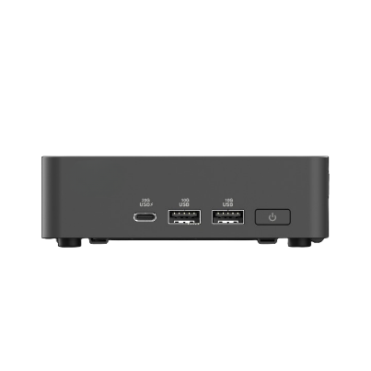
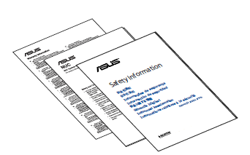
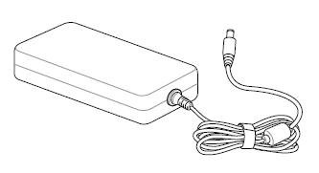
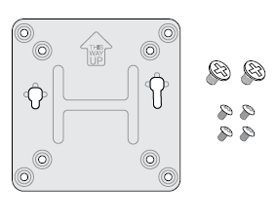
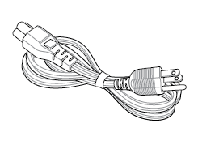
ASUS NUC 15 PRO
What’ s in the box
Mini PC
Or
(Tall)
(Slim)
Kit
NUC 15 PRO
(Tall)
Or
(Slim)
Inserts
Power Adapter
90 / 120 W
VESA bracket and Screws
Power Cord*
NOTE:
• The most up-to-date and accurate product specifications are available on www.asus.com for download.
• Product and accessory images are for illustrative purposes only. The actual appearance and specifications may vary depending on the model.
• *The bundled power adapter may vary depending on the model and the country (or region) of sale.
• Some bundled accessories may vary depending on the model. For details on these accessories, refer to their respective user manuals.
• If the device or its components fail or malfunction during normal and proper use within the warranty period, bring the warranty card to the ASUS Service Center for replacement of the defective components.
Specifications, content, and product availability are all subject to change without notice and may differ from country to country.
Actual performance may vary depending on the application, usage, environment, and other factors. Full specifications are available at http://www.asus.com

